Slide 1
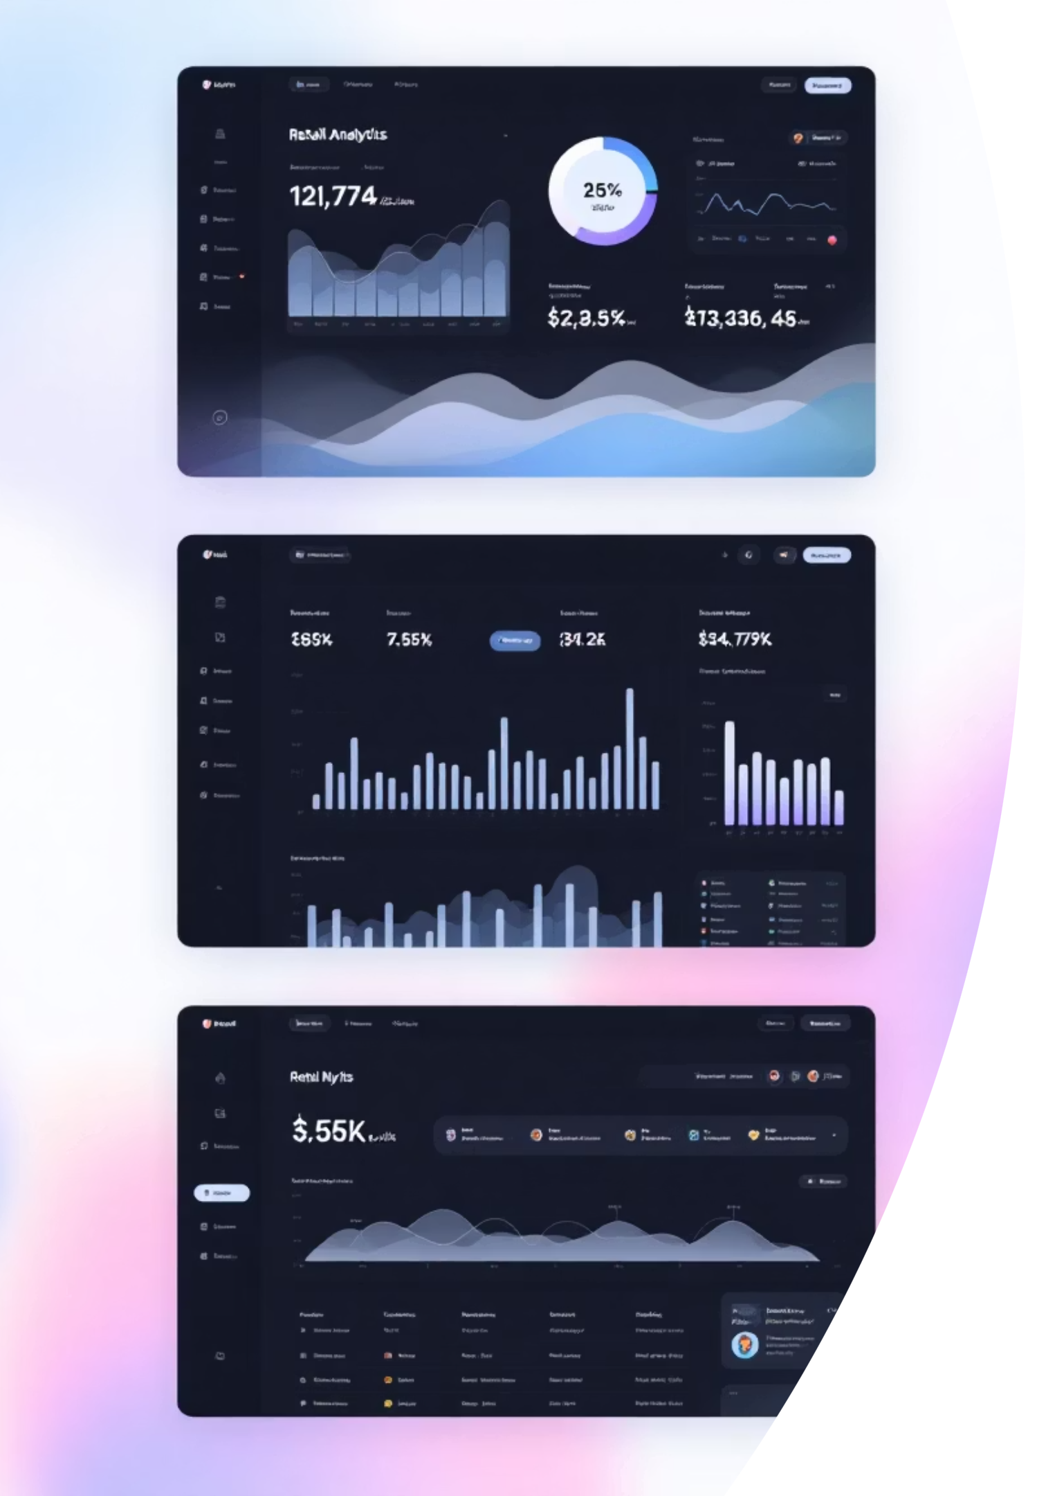
Customer Shopping Behavior Analysis
Uncovering insights from 3,900 purchases to drive strategic business decisions

Slide 2

Dataset Overview
3,900
18
25
Total Purchases
Data Points
Product Types
Transactions analyzed across all categories
Features tracked per customer
Items across 4 major categories
50
Locations
Geographic markets covered

Slide 3
Data Preparation Journey
01
02
Data Loading & Exploration
Missing Data Handling
Imported dataset, analyzed structure and summary statistics
Imputed 37 missing review ratings using category medians
03
04
Feature Engineering
Database Integration
Created age groups and purchase frequency metrics
Connected to PostgreSQL for advanced SQL analysis

Slide 4
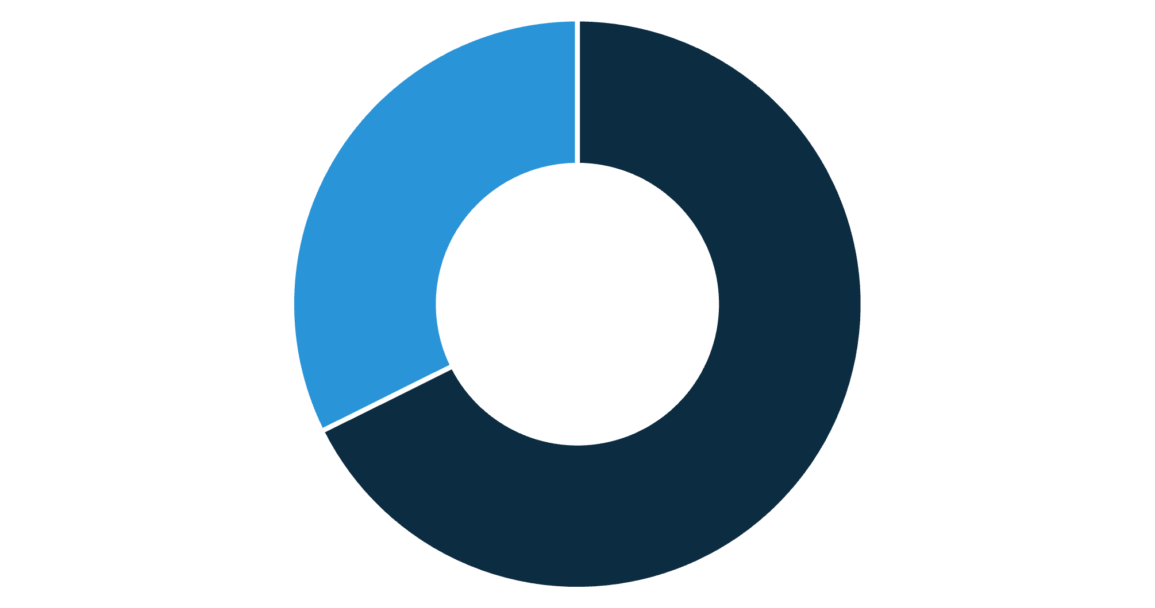
Revenue by Gender
Key Insight
Male customers generate 68% of total revenue, significantly outpacing female shoppers.
Strategic opportunity to boost female customer engagement and spending.
Male
Female

Slide 5

Top-Rated Products
1
2
3
Gloves
Sandals
Boots
Average rating: 3.86
Average rating: 3.84
Average rating: 3.82
4
5
Hat
Skirt
Average rating: 3.80
Average rating: 3.78

Slide 6

Shipping & Spending Patterns
Express Shipping
Standard Shipping
$60.48
$58.46
Average purchase amount
Average purchase amount
Express shipping customers spend 3.5% more per transaction—target this segment for premium offerings.

Slide 7


Subscription Analysis
Subscribers
1,053 customers
Avg spend: $59.49
Total revenue: $62,645
Non-Subscribers
2,847 customers
Avg spend: $59.87
Total revenue: $170,436
Subscribers represent only 27% of customers but maintain comparable spending levels—huge growth opportunity!

Slide 8
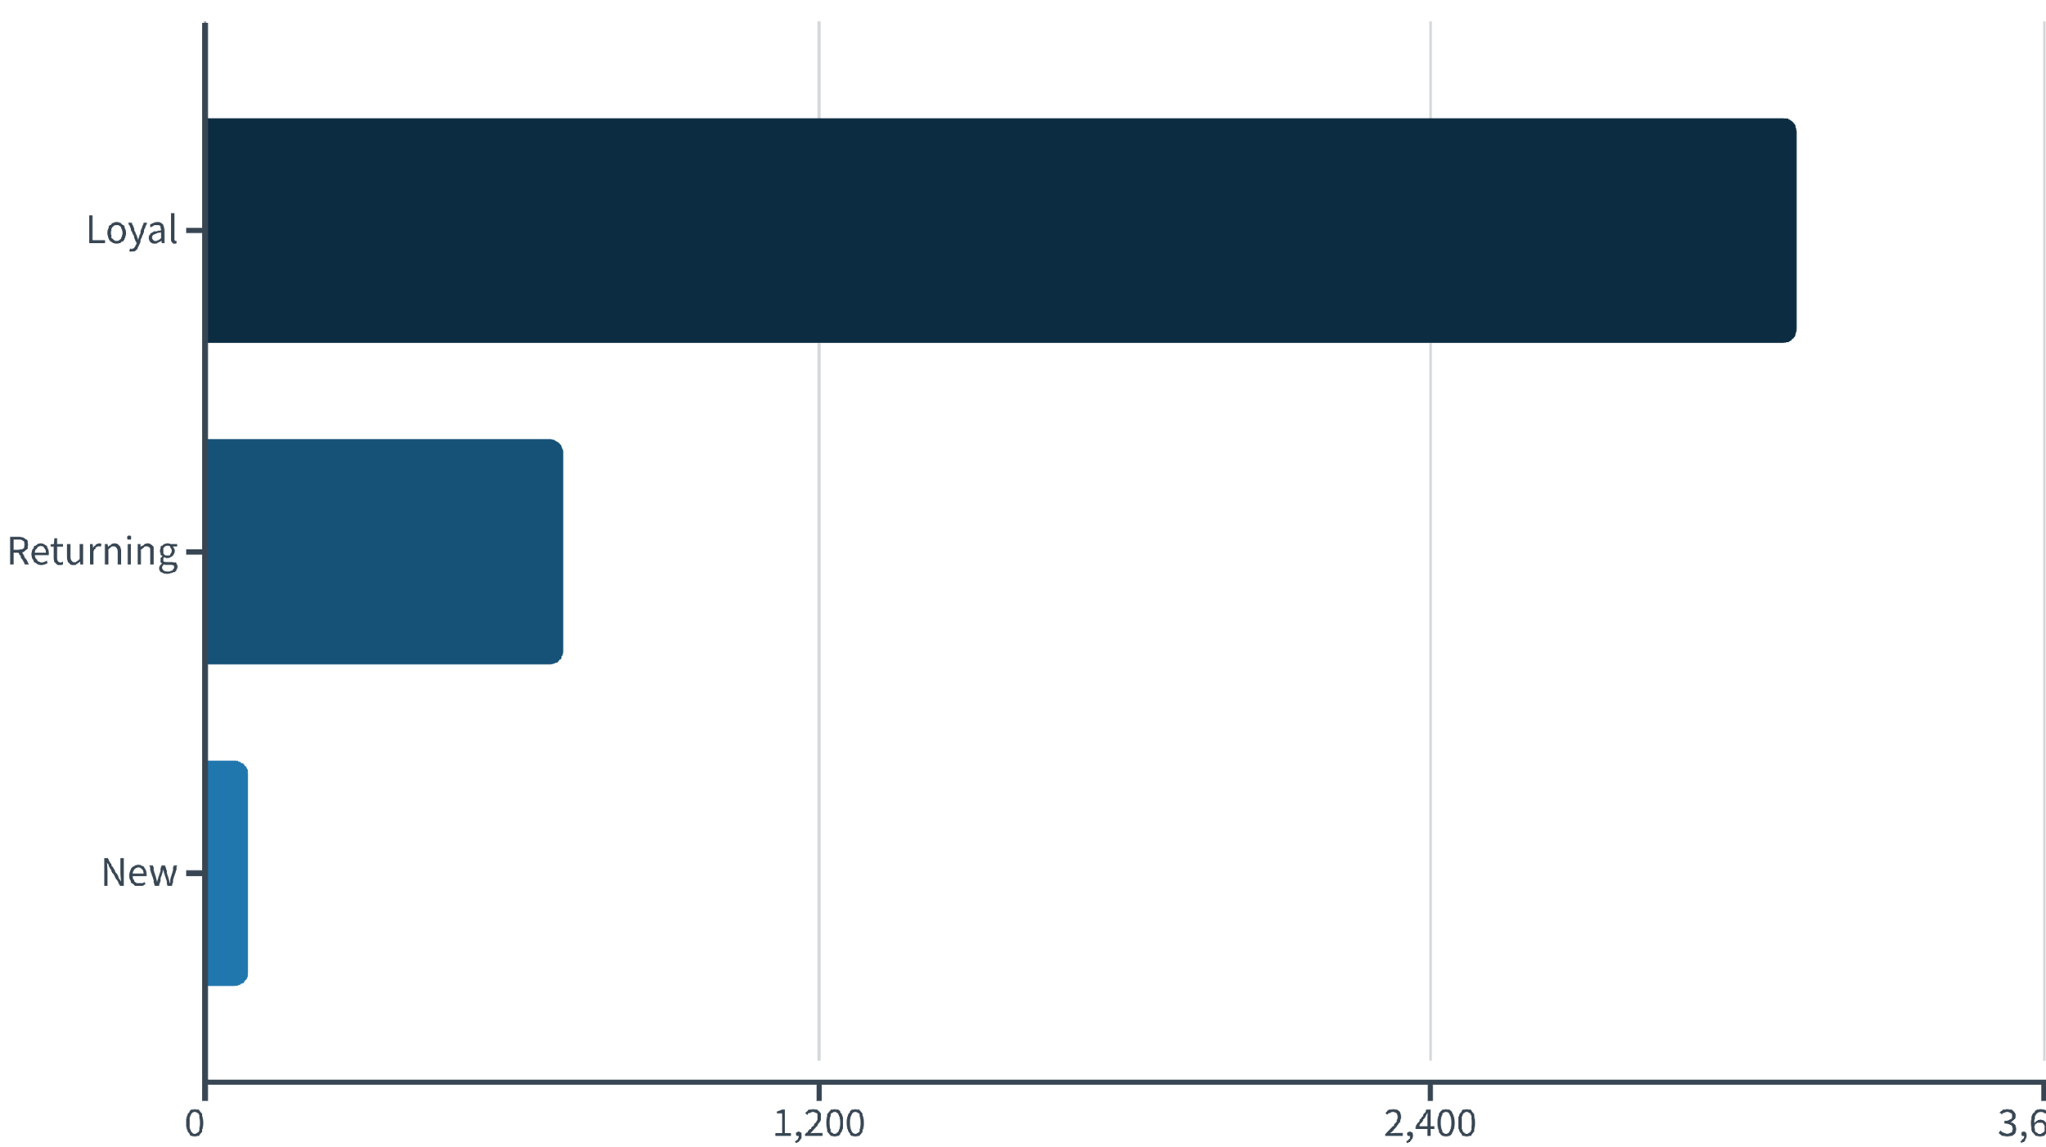
Customer Segmentation
Loyal (80%)
Returning (18%)
New (2%)
Strong retention base
Conversion opportunity
Acquisition focus needed

Slide 9



Revenue by Age Group
27%
25%
Young Adult
Middle-aged
$62,143 total revenue
$59,197 total revenue
24%
24%
Adult
Senior
$55,978 total revenue
$55,763 total revenue
Revenue distribution is remarkably balanced across age groups—multi-generational appeal confirmed.

Slide 10









Strategic Recommendations
Boost Subscriptions
Promote exclusive benefits to convert non-subscribers
Loyalty Programs
Reward repeat buyers to strengthen retention
Review Discounts
Balance sales boosts with margin control
Targeted Marketing
Focus on high-revenue segments and express shippers

